Slide 1

AI Journeys : Supervised Learning

Slide 2
Objectives
Machine Learning
Supervised Learning
Types of Supervised Learning
Hands on Session:
Regression - Linear Regression
Classification - K-NN Algorithm
Notes:
Hi my name is Aravind

Slide 3
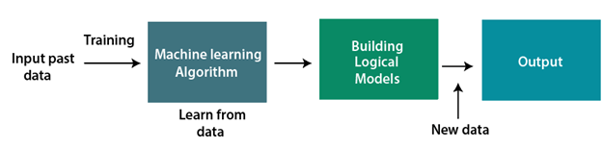
Machine Learning
A Machine Learning system learns from historical data, builds the prediction models, and whenever it receives new data, predicts the output for it.

Slide 4
Features of Machine Learning
Machine learning uses data to detect various patterns in a given dataset.
It can learn from past data and improve automatically.
It is a data-driven technology.

Slide 5
Need for Machine Learning
Rapid increment in the production of data.
Solving complex problems, which are difficult for a human.
Decision making in various sectors including finance.
Finding hidden patterns and extracting useful information from data.

Slide 6
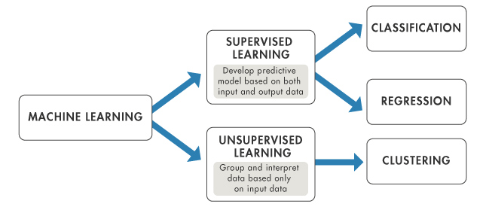
Classification of ML :
At a broad level, machine learning can be classified into three types:
Supervised Learning
Unsupervised Learning
Reinforcement Learning

Slide 7
Supervised Learning
Supervised learning is a type of machine learning method in which we provide sample labeled data to the machine learning system in order to train it, and on that basis, it predicts the output.
In the real-world, supervised learning can be used for Risk Assessment, Image classification, Fraud Detection, spam filtering, etc.

Slide 8
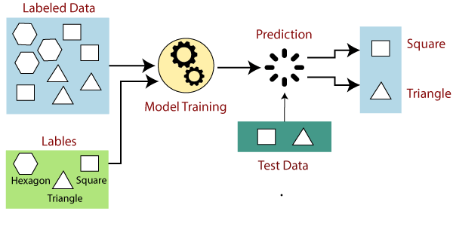
How it works ?
The aim of a supervised learning algorithm is to find a mapping function to map the input variable(x) with the output variable(y).

Slide 9
Advantages of Supervised Learning
Prediction based on prior experiences
Idea about classes of objects
Solve real-world problems
Disadvantages of Supervised Learning
Not suitable for complex tasks
Test data has to be from training data set
High computation time

Slide 10
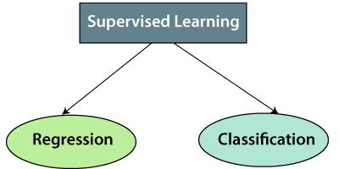
Types of Supervised Learning
Regression algorithms are used if there is a relationship between the input variable and the output variable. It is used for the prediction of continuous variables
Classification algorithms are used when the output variable is categorical, which means there are two classes such as Yes-No, Male-Female, True-false, etc.

Slide 11
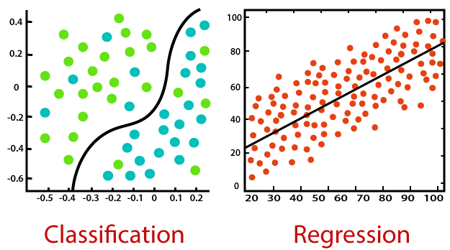
Regression vs. Classification

Slide 12
Regression
Regression is a process of finding the correlations between dependent and independent variables. It helps in predicting the continuous variables such as prediction of Market Trends, prediction of House prices, etc.
Regression Algorithms:
Linear Regression
Regression Trees
Non – Linear Regression
Bayesian Linear Regression
Polynomial Regression

Slide 13
Linear Regression
Linear regression analysis is used to predict the value of a variable based on the value of another variable. The variable you want to predict is called the dependent variable.
Non-Linear Regression
Nonlinear regression is a form of regression analysis in which data is fit to a model and then expressed as a mathematical function. Simple linear regression relates two variables (X and Y) with a straight line (y = mx + b), while nonlinear regression relates the two variables in a nonlinear (curved) relationship.
Polynomial Regression
polynomial regression is a form of regression analysis in which the relationship between the independent variable x and the dependent variable y is modelled as an nth degree polynomial in x. Polynomial regression fits a nonlinear relationship between the value of x and the corresponding conditional mean of y, denoted E(y |x).
Regression Tree
A regression tree is basically a decision tree that is used for the task of regression which can be used to predict continuous valued outputs instead of discrete outputs.

Slide 14
Classification
Classification is a process of finding a function which helps in dividing the dataset into classes based on different parameters. In Classification, a computer program is trained on the training dataset and based on that training, it categorizes the data into different classes.
Classification Algorithms:
K-Nearest Neighbours
Support Vector Machines
Random Forest
Decision Trees
Naïve Bayes

Slide 15
K-NN Algorithm
K nearest neighbors is a simple algorithm that stores all available cases and classifies new cases based on a similarity measure (e.g., distance functions).
Decision Tree
A decision tree is a type of supervised machine learning used to categorize or make predictions based on how a previous set of questions were answered. The model is a form of supervised learning, meaning that the model is trained and tested on a set of data that contains the desired categorization.
Random Forest
Random forest is a Supervised Machine Learning Algorithm that is used widely in Classification and Regression problems. It builds decision trees on different samples and takes their majority vote for classification and average in case of regression.

Slide 16

Simple Linear Regression
Linear regression algorithm shows a linear relationship between a dependent (y) and one or more independent (x) variables, hence called as linear regression.
The linear regression model provides a sloped straight line representing the relationship between the variables.

Slide 17
Mathematically, we can represent a linear regression as:
y= a0+a1x+ ε
Y = Dependent Variable (Target Variable) X = Independent Variable (predictor Variable) a0 = intercept of the line (Gives an additional degree of freedom) a1 = Linear regression coefficient (scale factor to each input value) ε = random error
The values for x and y variables are training datasets for Linear Regression model representation.

Slide 18
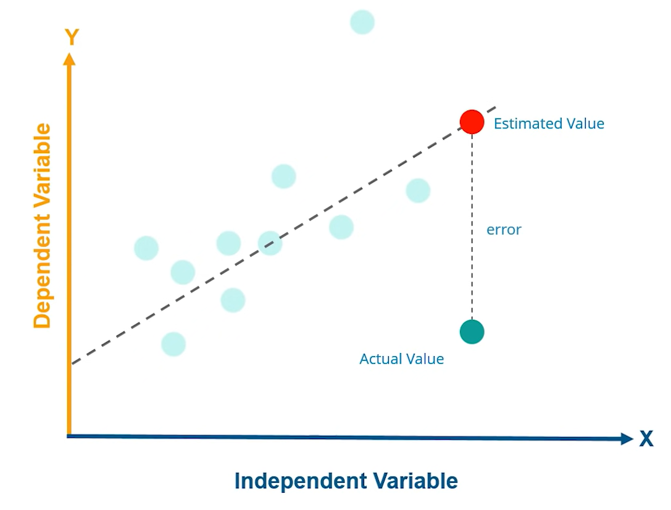
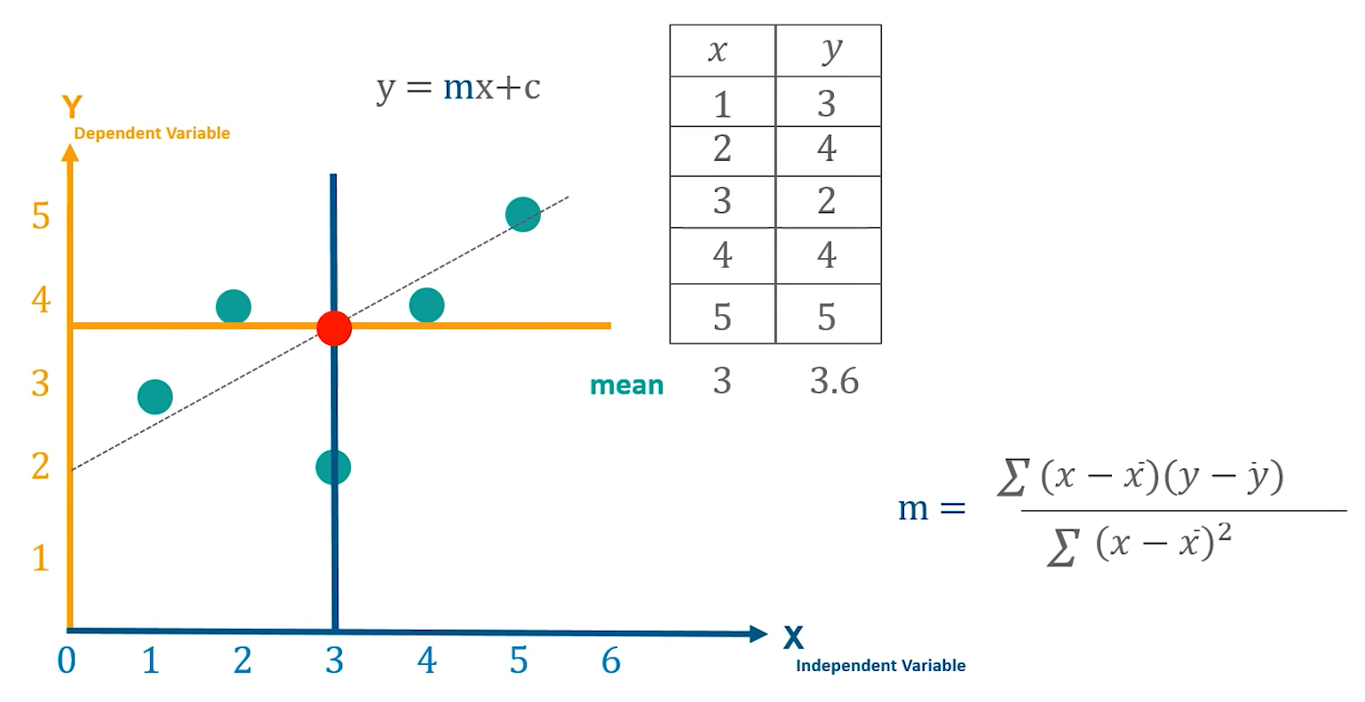
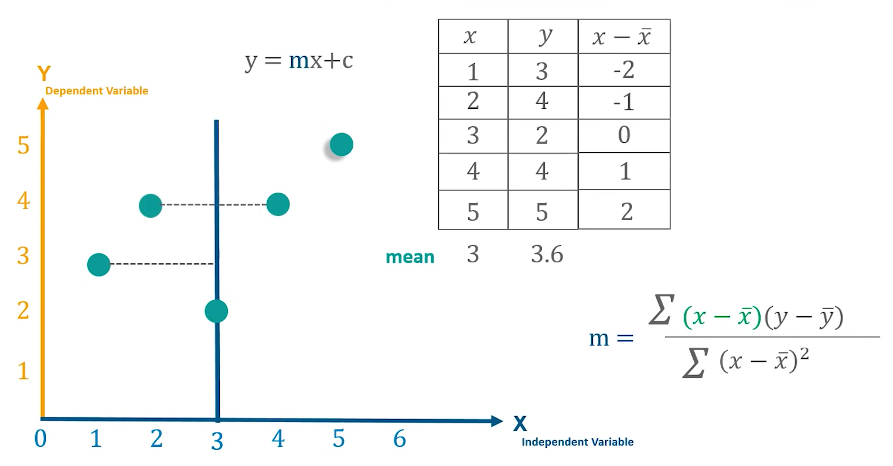
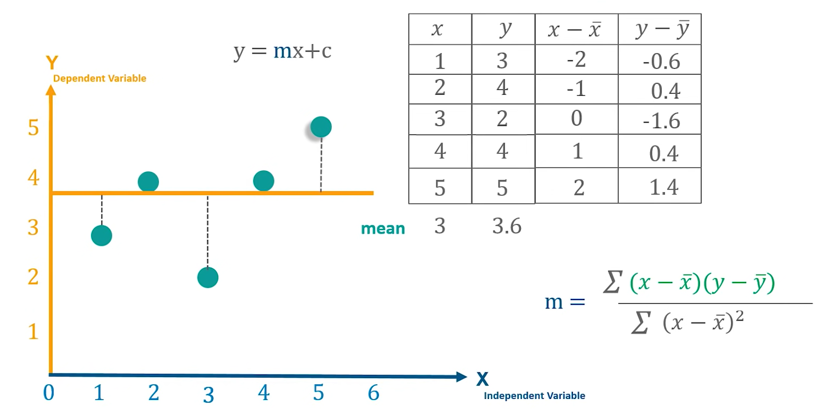

Slide 19
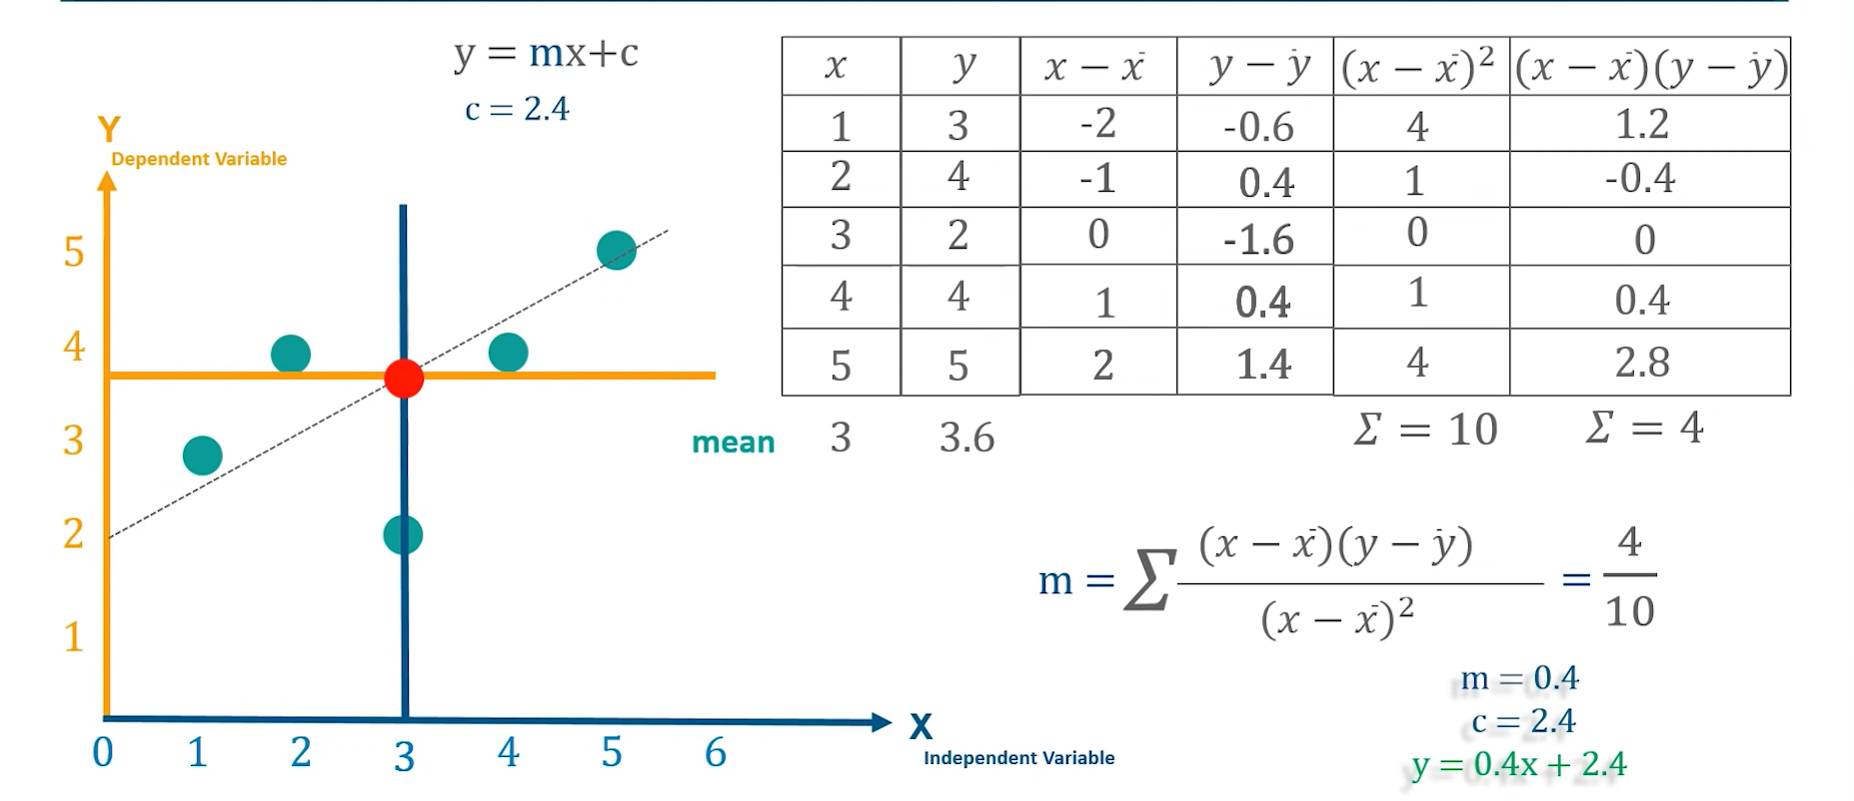

Slide 20
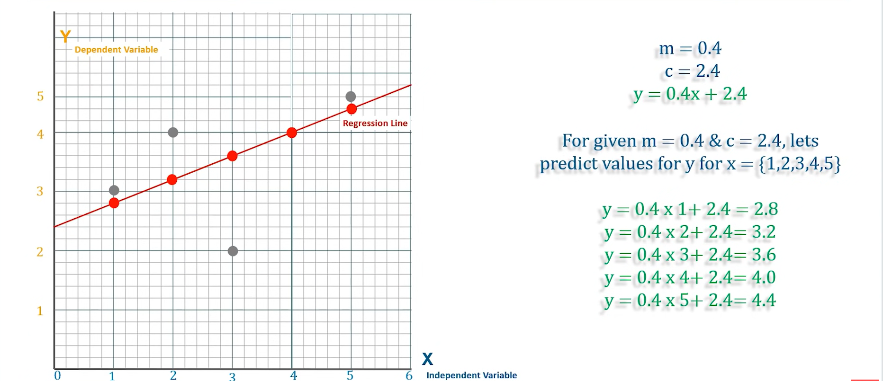

Slide 21
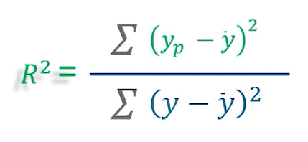
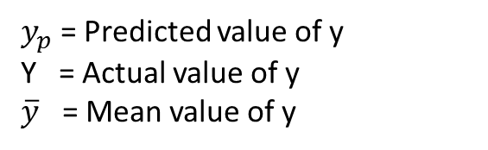
R- Squared Value
R-Squared value is a statistical measure of how close the data are to the fitted regression line
It is also known as the coefficient of determination, or the coefficient of multiple determination
Greater the R^2 value, more close are the data to the regression line.
$y_{p}$ = Predicted value of y
Y = Actual value of y
$\overline{y}$ = Mean value of y

Slide 22
K – Nearest Neighbours (K-NN)
K-Nearest Neighbors is an algorithm that solves a Classification Problem. Basically, given some data points with known classes and a new data point, we can predict the class of the latter using KNN.
This simple class prediction gives rise to machines that differentiate between cats and dogs, and more sophisticated ones that identify diseases from X Rays and MRI scans!

Slide 23
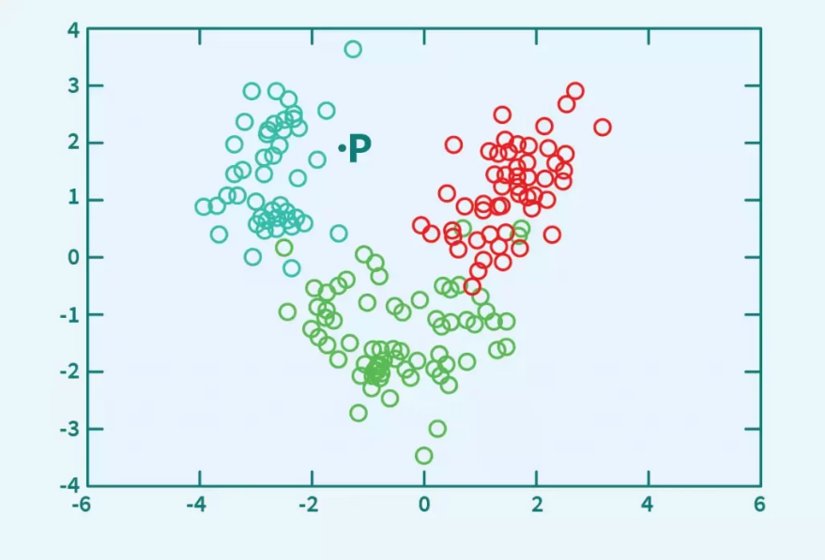
Let us consider an example
In a problem involving classification, we are given a set of data points and their classes. We have to classify a new datapoint into its appropriate/approximate class.
We are given the properties of 3 types of flowers (encoded as Red, Green and Blue) like their sepal width, sepal length, petal width and petal length, and we’ve obtained the following petal width vs. petal length graph.

Slide 24
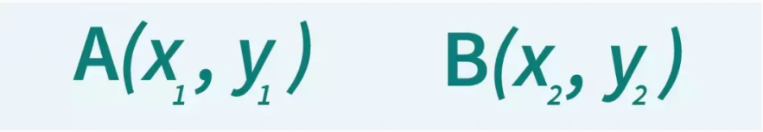
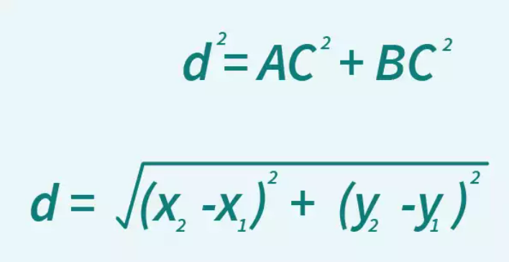
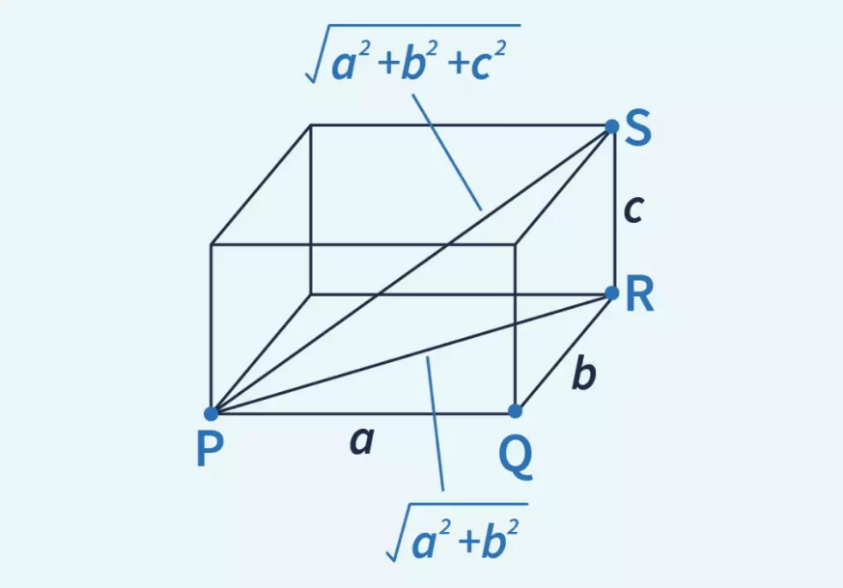
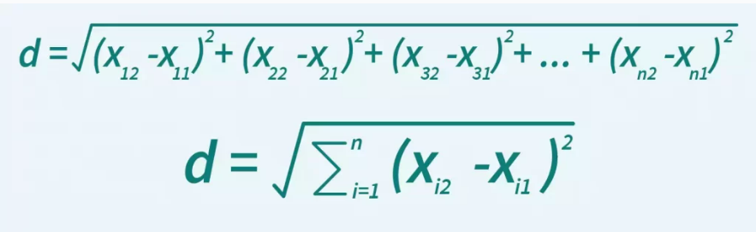

Slide 25

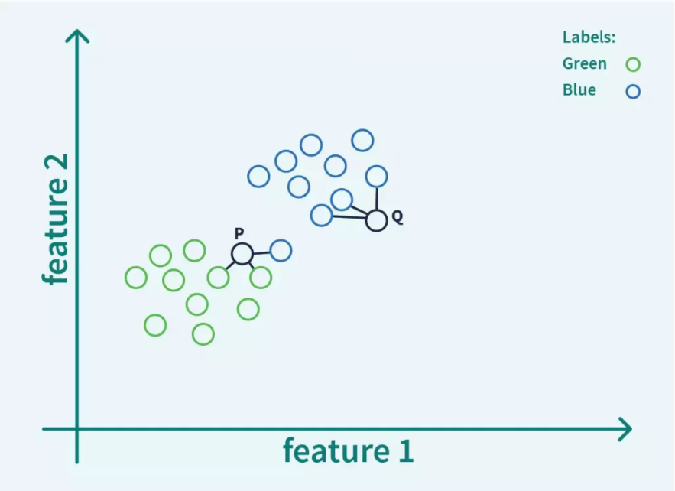
The way K-Nearest Neighbors works is that the program calculates the distances between the unknown point, and all the known points. Then, it considers the first k shortest distances and their labels. Each of these k distances is given a vote. The label with the most votes is assigned to the unknown point.
for k = 3
Votes = [blue, blue, blue]
Votes = [green, blue, green]

Slide 26
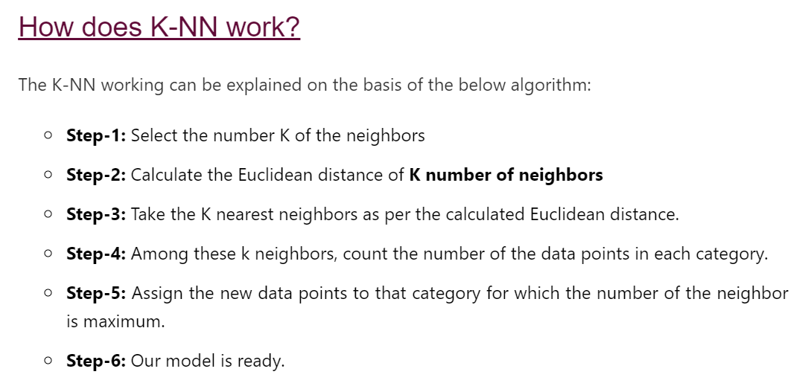

Slide 27
How to determine the value of k?
Choosing the right value of k in KNN is called hyperparameter tuning, and is crucial to get the best out of the model.
If the value of K is small, the error rate of the model will be large, especially for new datapoints, since the number of votes considered is small. The model is said to be overfitted, and highly sensitive to noise in the input.
On the other hand, if the value of K is large, the model’s boundaries become loose, and the number of misclassifications increase. In this case, the model is said to be underfitted.

Slide 28
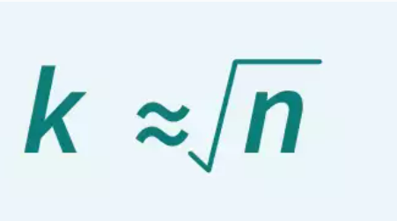
There is no fixed method to find k…
Set k as odd number
Set k as sqrt(n)

Slide 29
References used:
https://www.javatpoint.com/machine-learning
https://www.youtube.com/watch?v=E5RjzSK0fvY
https://www.scaler.com/topics/what-is-knn-algorithm-in-machine-learning/
https://www.javatpoint.com/k-nearest-neighbor-algorithm-for-machine-learning

Slide 30
Thank You !
Aravind S
Core Committee Member
VITMAS

